Slide 1
iCaRL: Incremental Classifier and Representation Learning
Accepted in CVPR 2017
Presenter: zelin
2022.6.1

Slide 2
Outline
Introduction
Method
Experiments
Conclusion

Slide 3
Outline
Introduction
Method
Experiments
Conclusion

Slide 4




Multi-class classification
Machine
Human
Feature
Extractor
ResNet
Representation
vector
Back-prop
cat
dog
Classifier
Learned
cat
dog
Notes:
Considering a multi-class classification problem,
For example, a baby could recognize cats and dogs given images of them
For machine

Slide 5
Multi-class classification
Machine
Human
Feature
Extractor
ResNet
Representation
vector
Back-prop
cat
dog
Classifier
Learned
cat
dog

Slide 6



Class Incremental
Machine
Human
Feature
Extractor
ResNet
Representation vector
cat
dog
horse
Classifier
Learned
New
cat
dog
horse
Notes:
However, when new classes come, human could incrementally recognize new concepts
While for deep neural networks

Slide 7
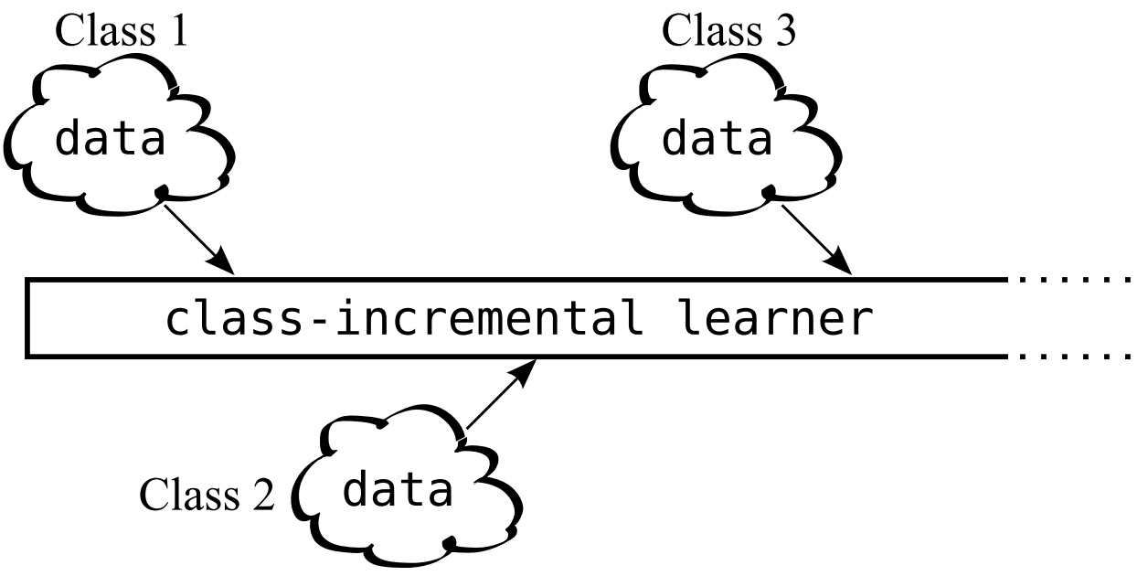
Class Incremental Learning
Definition for a qualified class-incremental algorithm:
Trainable with a stream of data with incremental classes
Competitive performance for all classes observed so far
Tolerable computational requirements & memory footprint
Notes:
This arouses the class incremental learning problem
The condition is, classes are not all available at the same time
Instead, different classes come sequentially, and we do not know exactly hoe many classes there could be
Therefore, a qualified class-incremental algorithm should 1. 2. 3.

Slide 8
Solution 1 (Re-training)
Modify the classifier architecture
Save training data of all classes
and re-train the whole model
when new class comes
Intolerable computation cost
and memory consumption!
Feature Extractor
ResNet
Representation vector
Back-prop
Classifier
cat
dog
horse
Notes:
We may come up with some intuitive solutions for this problem
The easiest solution is re-training, in which we 1. 2.
for example, we mix up training data of old Classes and new classes
And train a brand new model with the mixed data
However, since every time a new class emerges, the whole model should be re-trained with all training data observed so far, which suffers from

Slide 9
Solution 2 (Fine-tuning)
Modify the classifier architecture
Fine-tune the model
only with samples from new classes
Feature Extractor
ResNet
Representation vector
Back-prop
Classifier
cat
dog
horse
Notes:
The second naïve solution is fine-tuning
Where we do not store any data of old classes
We add classifier weights for new classes
and finetune the original model only with images from new classes

Slide 10
Solution 2 (Fine-tuning)
Modify the classifier architecture
Fine-tune the model
only with samples from new classes
Feature Extractor
ResNet
Representation vector
Back-prop
Classifier
cat
dog
horse
Notes:
After back-prop, parameter of classifiers and feature extractors are both changed

Slide 11
Solution 2 (Fine-tuning)
Modify the classifier architecture
Fine-tune the model
only with samples from new classes
Quiz:
Accuracy on old classes would
A. Sustain
B. Decline
C. Improve
Reason?
Feature extractor weights changed
Bias towards newly learnt classes
Feature Extractor
ResNet
Representation vector
Classifier
Catastrophic forgetting!
cat
dog
horse
Notes:
Here comes the first quiz
after finetuning, ...
or catastrophic interference

Slide 12
Solution 3 (Fixed representation)
Freeze the parameters of feature extractor
Only train classifier weights of new classes
Feature Extractor
ResNet
Representation vector
Classifier
Back-prop
cat
dog
horse
Notes:
So, a natural idea is that we 1. 2.

Slide 13
Solution 3 (Fixed representation)
Freeze the parameters of feature extractor
Only train classifier weights of new classes
Quiz:
Accuracy on old classes would
A. Sustain
B. Decline
C. Improve
Reason?
Feature Extractor
ResNet
Unsatisfying
incremental performance
on new classes
Representation vector
Classifier
Back-prop
cat
dog
horse
Notes:
here come the second quiz
However, this may cause

Slide 14
Solution 4 (Fixed representation & kNN)
Freeze the feature extractor
Nearest-Neighbor classifier
Feature Extractor
ResNet
🤔
Not completely
solve the problem
Representations vectors
in training set
kNN
Nearest-class-mean (NCM)

Slide 15
iCaRL
Fine-tuning on new classes & Rehearsal on old class exemplars
Note:
Exemplars – representative images for each class
Knowledge distillation loss for rehearsal
Nearest-mean-of-exemplars algorithm for classification
Prioritized exemplar selection based on herding
Notes:
Therefore, the authors proposed an algorithm called iCaRL
To Inherit their advantages & Avoid their shortcomings
iCaRL works by …
Note here …
In details, iCaRL …

Slide 16
Storing all images of old classes
Feature Extractor
ResNet
Representation vector
🤔
High storage
& computational cost!
Classifier
cat
dog
horse
Notes:
Since it's quite abstract, I made some illustrations for their intuitions and procedures
As we've mentioned before, storing all images of old classes like re-training
Would cause

Slide 17
Storing no images of old classes
Feature Extractor
ResNet
Representation vector
🤔
Unsatisfying
performance!
Classifier
cat
dog
horse
Notes:
While storing no images of old classes like fine-tuning would cause … like catastrophic forgetting on old classes

Slide 18
iCaRL
Fine-tuning on new classes
& Rehearsal on old class exemplars
2. Nearest-mean-of-exemplars classifier
Storing exemplar images
for each old class
Feature Extractor
ResNet
Representation vector
Classifier
cat
dog
horse
Notes:
iCaRL propose to store part of training data for each class
The main idea is ...

Slide 19
iCaRL
Fine-tuning on new classes
& Rehearsal on old class exemplars
2. Nearest-mean-of-exemplars classifier
Training
Storing exemplar images
for each old class
Inference
Exemplar vectors
Feature Extractor
ResNet
Representation vector
Classifier
mean vectors
Nearest-mean-of-exemplars classifier
cat
dog
horse
Notes:
during training
during inference

Slide 20
Outline
Introduction
Method
Experiments
Conclusion

Slide 21
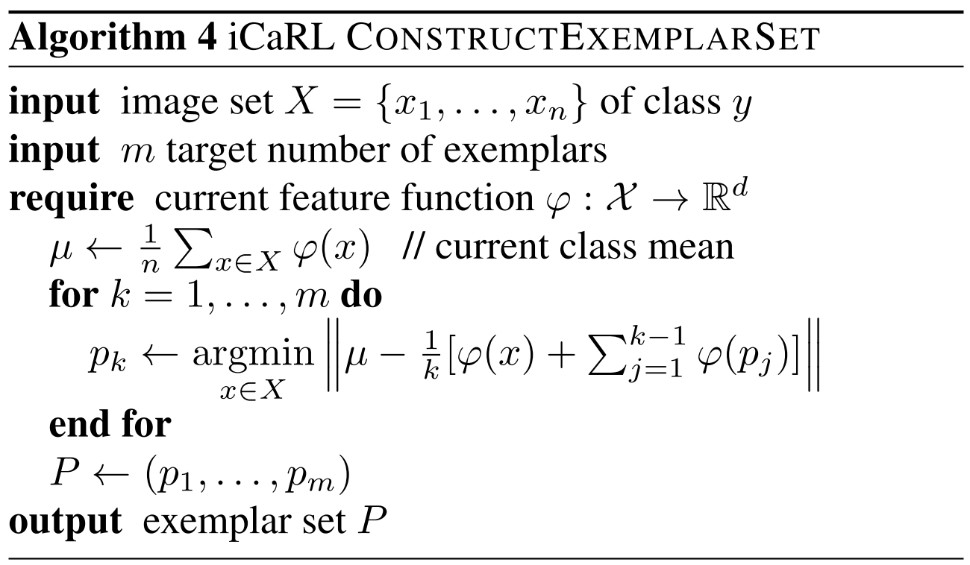
Prioritized exemplar selection (herding)
Selecting exemplars for each class observed so far
representative images
6
4
1
2
Class mean vector
3
5
The numbers are the
distance to mean vector
Quiz:
The first exemplar vector?
The second exemplar vector?
Notes:
So here the major problem is, how can we select the most important images of each class?
For example we have 1k images for each class, how can we select the most important 10 images to represent their corresponding classes
The authors adopted a … algorithm to form a priority list of exemplars
They iteratively select exemplars to ensure that the average of exemplars best approximates the class mean
For example, this figure shows vectors of a certain class
the quiz is

Slide 22
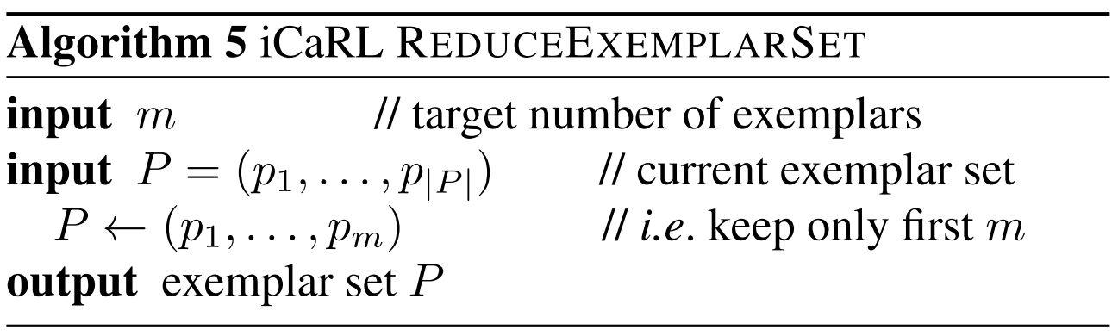
Exemplar Management
Memory storage for all exemplars are limited to K images
When new classes with their new exemplars come, we may shrink the size of exemplars for old classes
Benefit of herding: Prioritized list
We could simply cut off the latter ones
while preserves the more important ones
Notes:
Assume that …

Slide 23
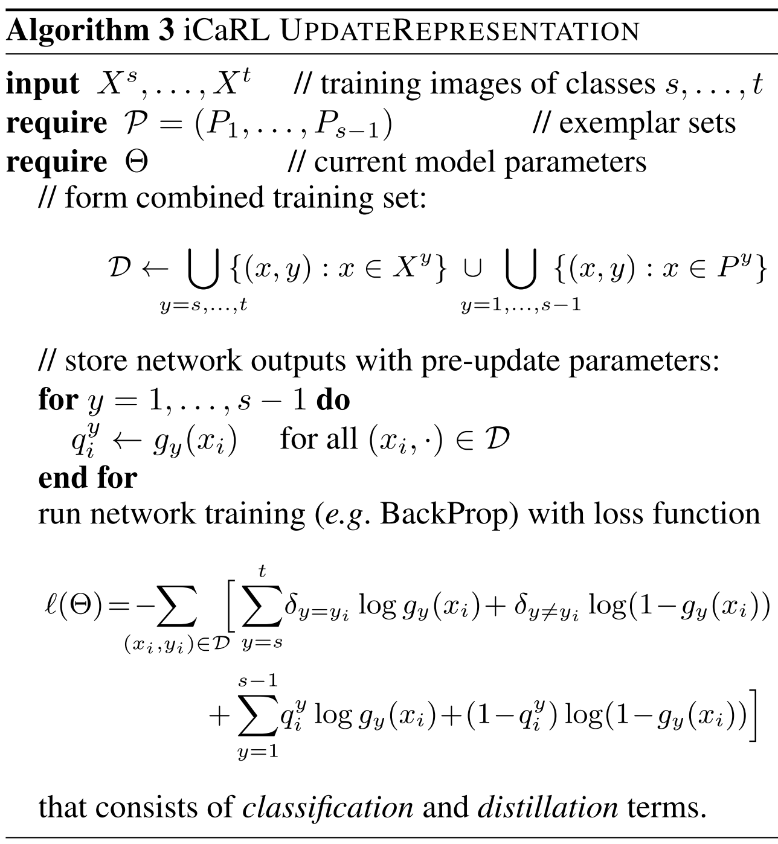
Representation Learning
Fine-tuning: learn the representation of new classes
Samples from new classes & Exemplars of old classes
BCE loss for new classes
Distillation loss for old classes
Rehearsal: Prevent logits of old classes from drifting away too far
Notes:
Given samples from new classes and exemplars of old classes, how do we update the representation incrementally?
Here we can see training set is the combination of new class samples and old class exemplars
iCaRL adopts both finetuning and rehearsal strategies, revealed in their losses

Slide 24
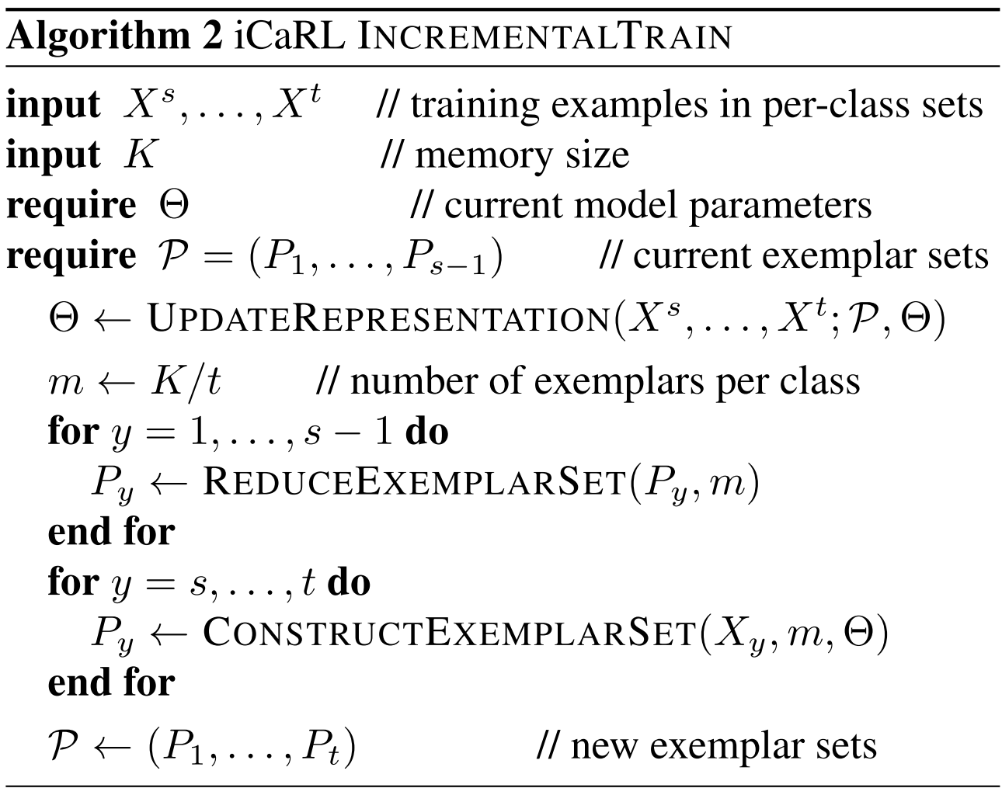
Incremental Training Procedure
Neural network training
Exemplar management
Notes:
The whole incremental training procedure is composed of …
When new classes come, the whole model is updated with back propagation
Then, exemplar sets of old classes are shrinking, while exemplar sets for new classes are constructed

Slide 25
iCaRL
Fine-tuning on new classes
& Rehearsal on old class exemplars
2. Nearest-mean-of-exemplars classifier
Training
Storing exemplar images
for each old class
Inference
Exemplar vectors
Feature Extractor
ResNet
Representation vector
Classifier
mean vectors
Nearest-mean-of-exemplars classifier
cat
dog
horse
Notes:
Recall the iCaRL framework
Apart from training, inference is done by Nearest-mean-of-exemplars classifier

Slide 26
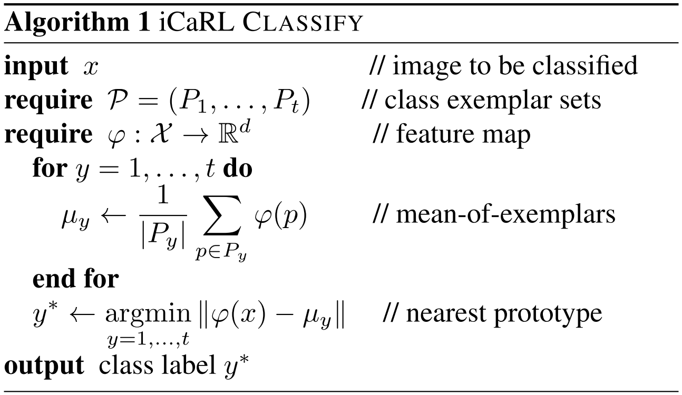
Inference Procedure
Instead of classifying using logits of each class, the author propose a Nearest-mean-of-exemplars algorithm
Center (prototype) of each class
is represented by mean vector of exemplars
Find the nearest class center (prototype)
Notes:
While inference, …
Resembling Nearest Neighbor classification
And the nearest class center is predicted as the answer

Slide 27
Outline
Introduction
Method
Experiments
Conclusion

Slide 28
Benchmark protocol
iCIFAR-100 benchmark
train all 100 classes in batches of 2, 5, 10, 20 or 50 classes at a time
iILSVRC benchmark
using only a subset of 100 classes, which are trained in batches of 10 (iILSVRC-small)
using all 1000 classes, processed in batches of 100 (iILSVRC-full)
Notes:
which has two versions
the first setting
the second setting

Slide 29
Baselines
No extra memory storing samples for old classes
1. Fixed representation (fixed repr.)
Freeze the feature extractor after the first batch of classes has been processed
Update classifier weights of new classes
2. Fine-tuning
Learning a multi-class classifier for new incoming classes by finetuning both feature extractor and classifier weights
Notes:
They compare iCaRL with three baseline systems

Slide 30
Baselines
No extra memory storing samples for old classes
3. Learning without Forgetting (LwF)
iCaRL:
BCE loss for new class samples
and new classifier weights
Distillation loss for old exemplar samples
and old classifier weights
LwF:
BCE loss for new class samples
and new classifier weights
Distillation loss for new class samples
and old classifier weights
BCE loss for new class weights
Distillation loss for old class weights
Notes:
The strongest baseline is called …
The losses are similar with iCaRL, while LwF does not need any extra memory
Here is the comparison between iCaRL and LwF

Slide 31
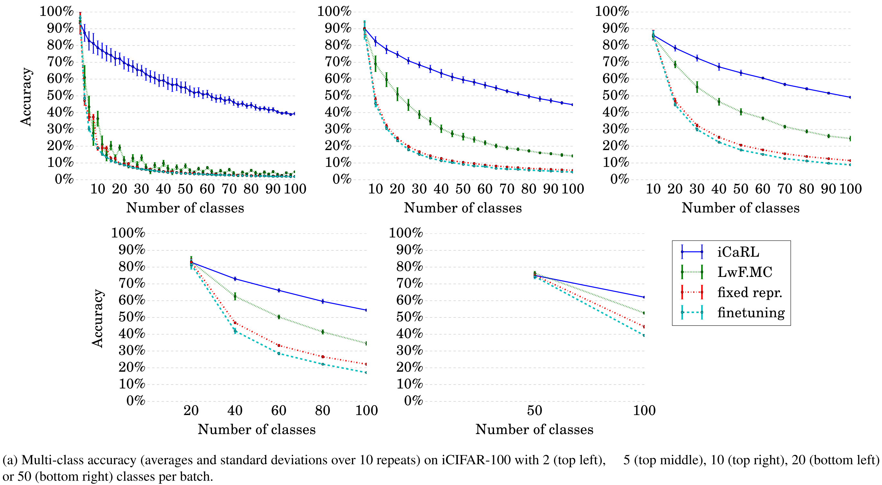
iCIFAR-100
Notes:
Here are the accuracy on iCIFAR-100 when classes increments in different batch sizes
We can see LwF is always the second best, while fixed representation and finetuning often quickly fails

Slide 32
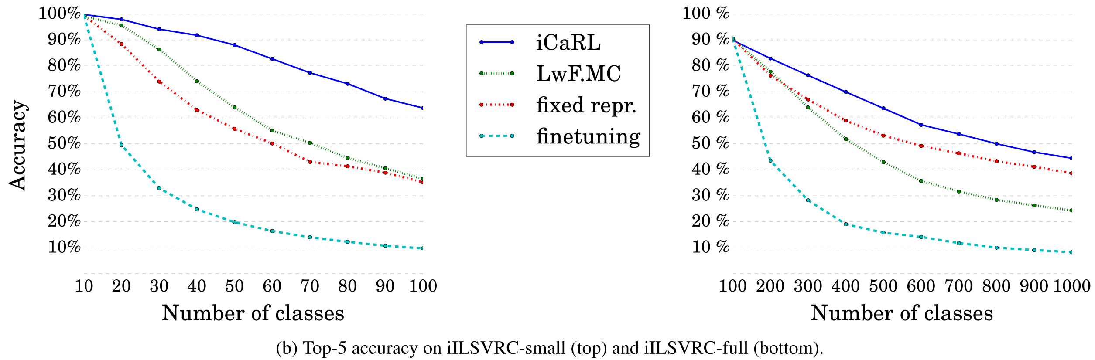
iILSVRC
fixed repr. outperforms LwF
after first 100 classes
Notes:
On iILSVRC, there is an opposite case where …
This might because the first 100 classes are enough for learning a good feature extractor
while distillation loss instead hurts the performance

Slide 33
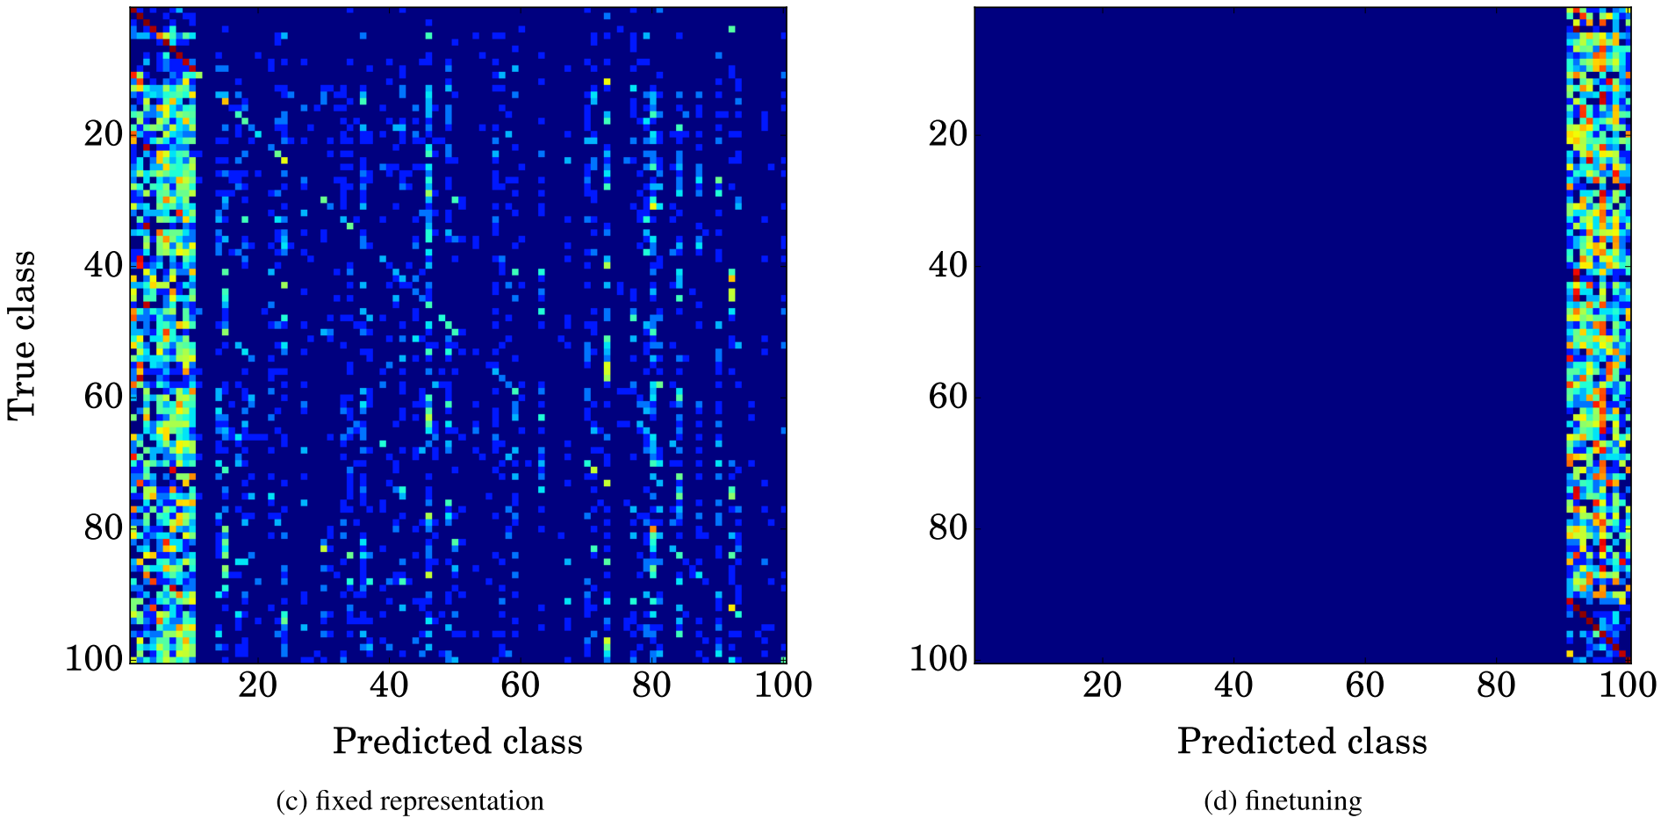
Confusion matrices
Notes:
Here are the confusion matrices of each method
The classifier with fixed representation has a bias towards classes from the first batch, while the network trained by finetuning predicts exclusively classes labels from the last batch.

Slide 34
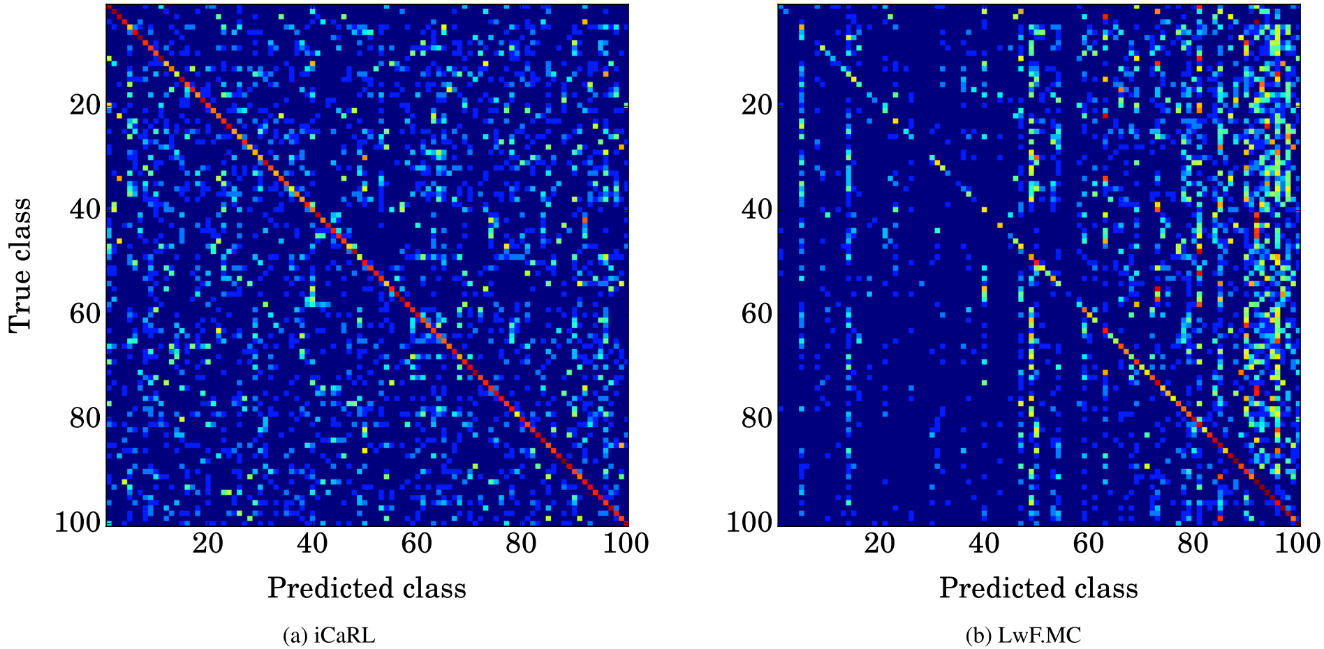
Confusion matrices
Notes:
iCaRL's predictions are distributed close to uniformly over all classes,
looks homogeneous over all classes, both in terms of the diagonal entries (i.e. correct predictions) as well as off-diagonal entries (i.e. wrong predictions)
whereas LwF.MC tends to predict classes from recent batches more frequently.

Slide 35
Ablation study
Hybrid 1
w/o mean-of-exemplar classifier (exemplars are used in training)
Hybrid 2
w/o distillation loss during training
Hybrid 3
Re-train the whole model using exemplars and new class samples
with BCE loss
Notes:
The authors also do ablation study on three alternatives

Slide 36
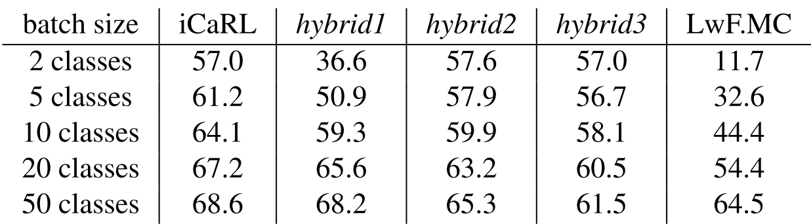
Ablation study
hybrid 1: (-) mean-of-exemplar classifier
hybrid 2: (-) distillation loss during training
hybrid 3: Re-train using exemplars and new class samples
iCIFAR-100
Distillation loss hurts performance
in extreme small incremental conditions
mean-of-exemplars classifier
shows advantage in small incremental conditions
Notes:
The results in iCIFAR-100 are in this table
Nonetheless, in most conditions they all outperforms LwF

Slide 37
Outline
Introduction
Method
Experiments
Conclusion

Slide 38
Conclusion
In this work,
The authors introduced iCaRL, a strategy for class-incremental learning that learns classifiers and feature representations simultaneously
The main reason for iCaRL's strong classification results are its use of exemplar images (rehearsal & mean-of-exemplar classify)
However, iCaRL's performance is still lower than systems with all training examples of all classes available at the same time
Future work: Filling the performance gap & use less or no storage

Slide 39
Thanks!

